Slide 1
Recitation 12

Slide 2
Info
Jon Rutkauskas
Recitation: Tue 12-12:50
Office Hours: Tue 11-11:50 Thur 11-12:50 SENSQ 5806 (additional hours by appointment if needed)
On discord: @jrutkauskas
By email: jsr68@pitt.edu
Website: https://github.com/jrutkauskas/spring2019-449-rec
Ask me any questions you have!!!

Slide 3
Warmup Poll

Slide 4
“Stick” Around…
Still have stickers!

Slide 5
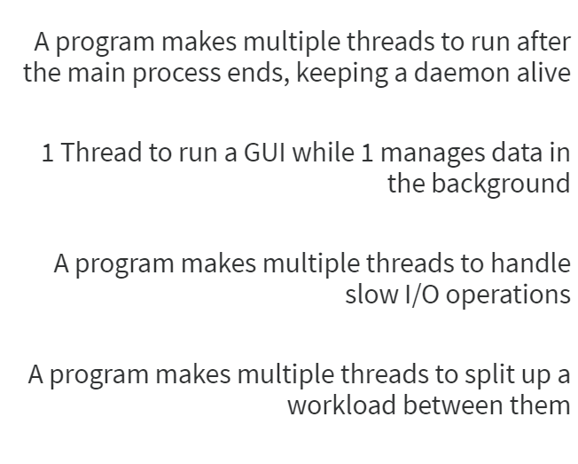
Which of these is NOT a valid use case for threads.

Slide 6
Which of these is NOT a valid use case for threads.
When a PROCESS ends, its threads end with it.
When the main thread ends, you might be able to keep the threads from dying by using “Joining” with those threads, but if a process is dead, so are its threads, generally
The rest are all valid use cases for interactive programs, handling data, slow IO operations, or splitting up workloads.

Slide 7
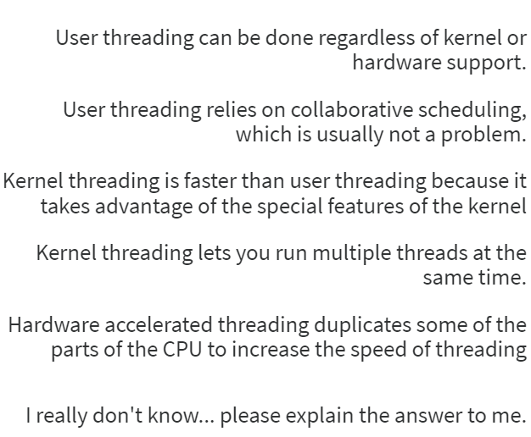
Which of the following is NOT true about threading?

Slide 8
Which of the following is NOT true about threading?
User threading is done by a library that runs in userspace and handles threading. To the kernel, it’s just one process running, it just jumps around in its execution.
Since user-mode processes can’t use interrupts, they rely on collaborative scheduling, that is, threads willingly yielding control back to other threads. This is usually not a problem since all your threads are typically running only code you wrote, so just write good code. The process holding them all is still scheduled normally using the kernel
Kernel threading is slower because switching between threads now requires context switching.
Kernel threading DOES let you run multiple threads at the same time, though, on multiple CPU cores.
H/W accelerated threading will have some of the CPU components, like registers, duplicated so when we switch threads, instead of saving all those registers and clearing out the other parts, we can just switch which parts we’re using.

Slide 9
Lab 8: Basic Multithreading
Making a program to set alarms for n seconds from now
Follows very closely the code in the example files
Plus, all the user interaction is already written for you.
Honestly not a lot of code, mostly just knowing what to copy and modify, and the basic concept of the program.
Ask me about mutexes, since you haven’t talked about them in class yet.

